Slide 1


WELCOME TO THE HELPING-BUDDY

Slide 2


CONTENT :
Introduction
Objective
Existing work
Scope
Block diagram
Methodology
Technology stacking
Snap shot
Conclusion
Future scope

Slide 3

Introduction :
Helps user to find the old age and orphan age homes.
User can make donations easily.
User friendly interface.
Decrease the wastage of donation.
Can make financial donations and also book time slot if available to donate food.

Slide 4

Objectives :
This website named Helping Buddy helps to overcome on the problems like -
wastage of donated material
irregularity in help
efficient use of helps and donations.

Slide 5

Existing work :
The "Helping Buddy" website facilitates donations for disaster relief, old age homes, and orphanages. Key features include user registration, donation management, cause information, real-time updates, search options, profiles with donation history, communication tools, security measures, social sharing, feedback, mobile responsiveness, and legal compliance. The existing work involves developing these features to create a user-friendly and transparent platform for charitable contributions.

Slide 6
Purposed system with scope :
Donation Management:
Donators can donate what they want to the different recipients including the people who are suffered due to disasters.
Efficient Use of Donations:
Sometimes the donated food or material get wasted due to large amount of donations so this project will help us to utilize the full amount of donations without any wastage.
Appointment for Donations:
As mentioned above the multiple donations at same time causes wastage or no use of that donations so this project will help us to check what type of donations receivers required and as per requirement and donators time availability, he can take an appointment to make the donations.
Finding NGO:
This project helps to find the NGO, old age homes, orphan age homes and such more institutions in our area.

Slide 7
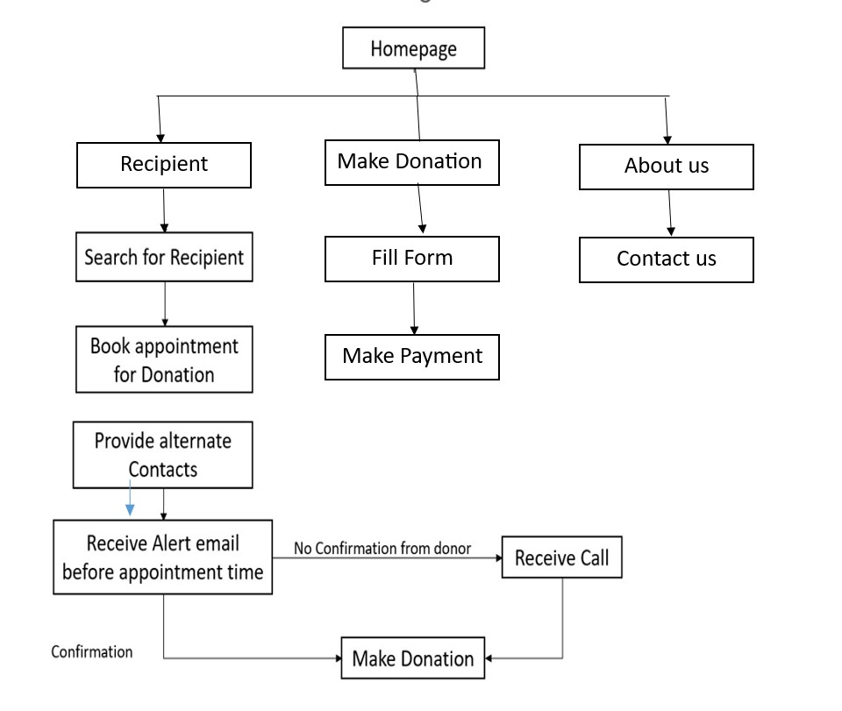
Block Diagram :

Slide 8


Methodology :
1. Method of data collection
The data collection process for disaster management system involves diverse methodologies. Surveys and questionnaire to social workers and NGOs administration gives insights into management issue. Interview with disaster affected people provides qualitative perspective. Discussing with on field social workers helped in corresponding
2. Method of data analysis
By conducting survey and the articles available on the websites we came to know that inefficient use of donations and the peoples want to donate but they don’t have any idea where they should make these donations. Also, the data of donor received from NGO or from government offices.

Slide 9
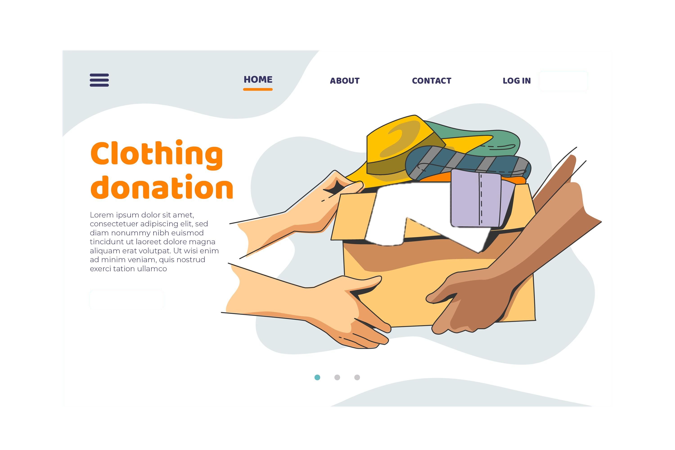
Technology stacking :
Front end :
HTML(Hyper Text Markup Language)
CSS (Cascading Style Sheet)
JavaScript
Back end :
PHP(Hypertext PreProcessor)
MySql (Database)
XAMPP

Slide 10
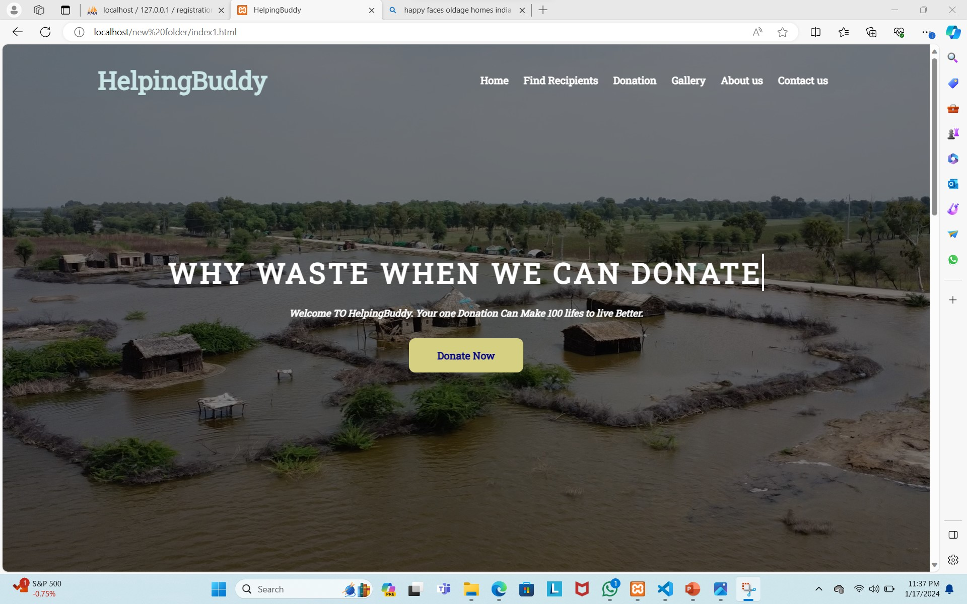
Snap shots :
HOMEPAGE

Slide 11
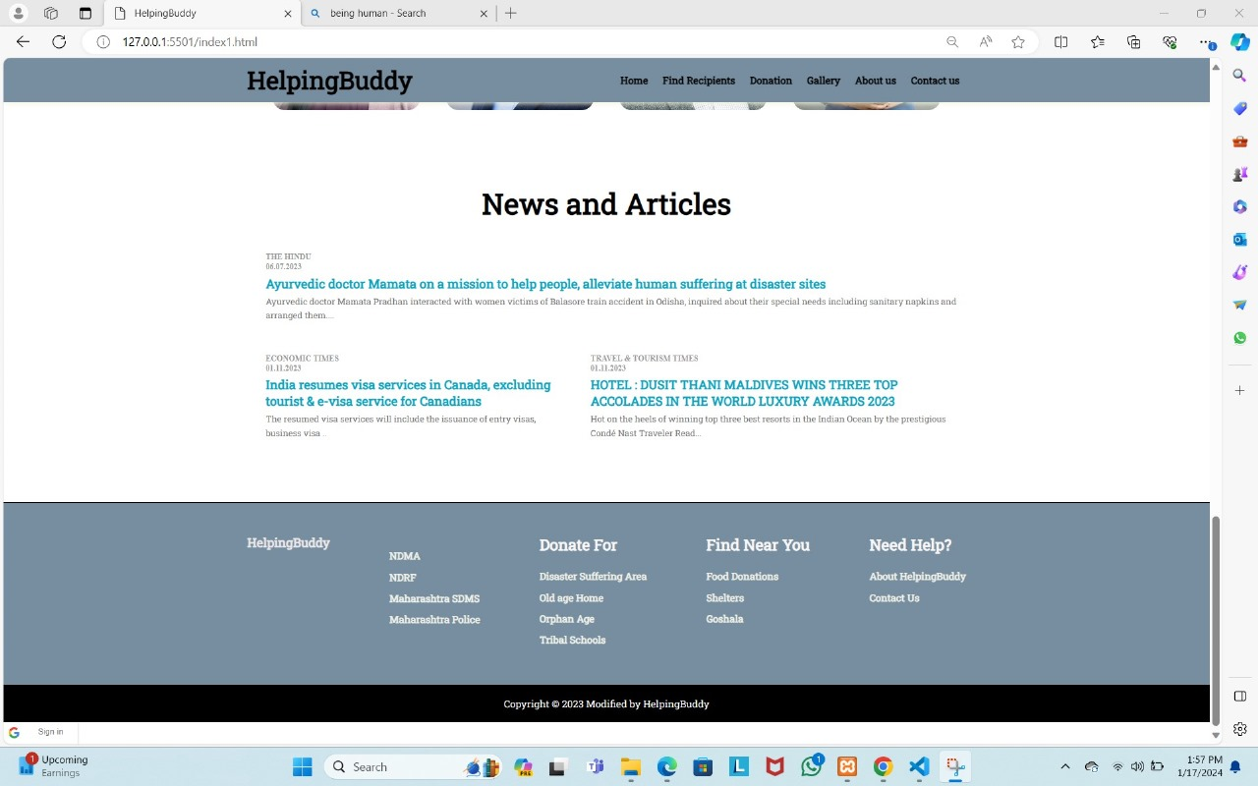
NEWS AND
ARTICLE

Slide 12
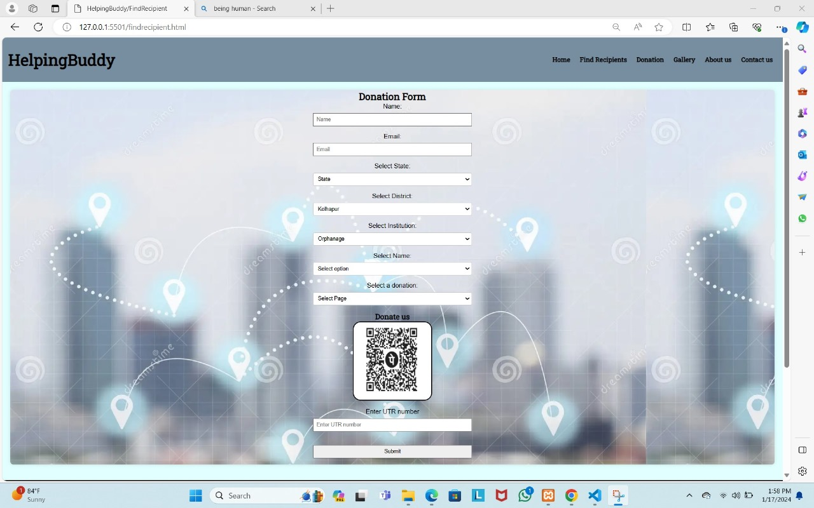
FIND
RECIPIENT

Slide 13
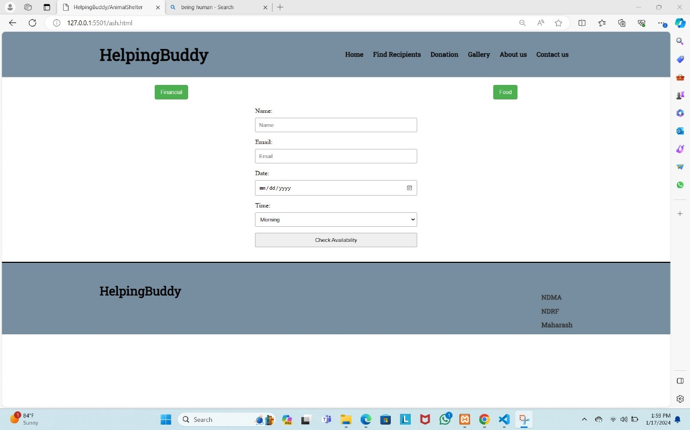
DONATION

Slide 14
FOOD
DONATION

Slide 15
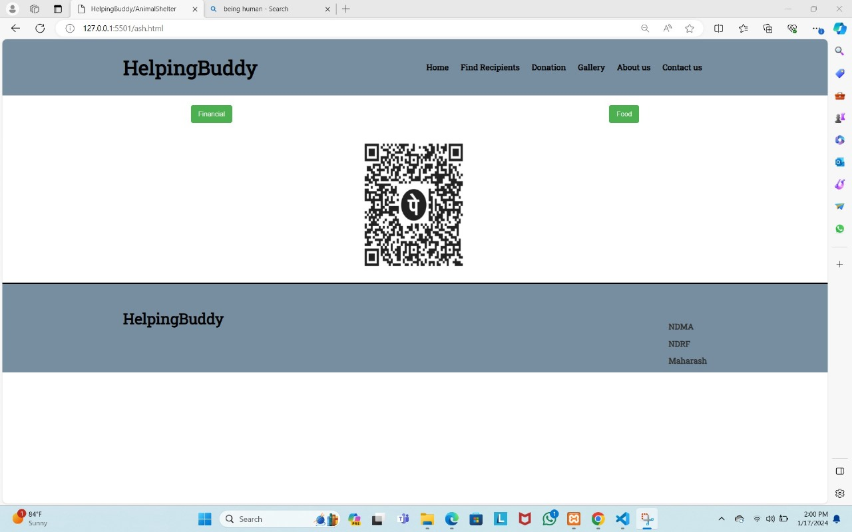
FINANCIAL
DONATION

Slide 16
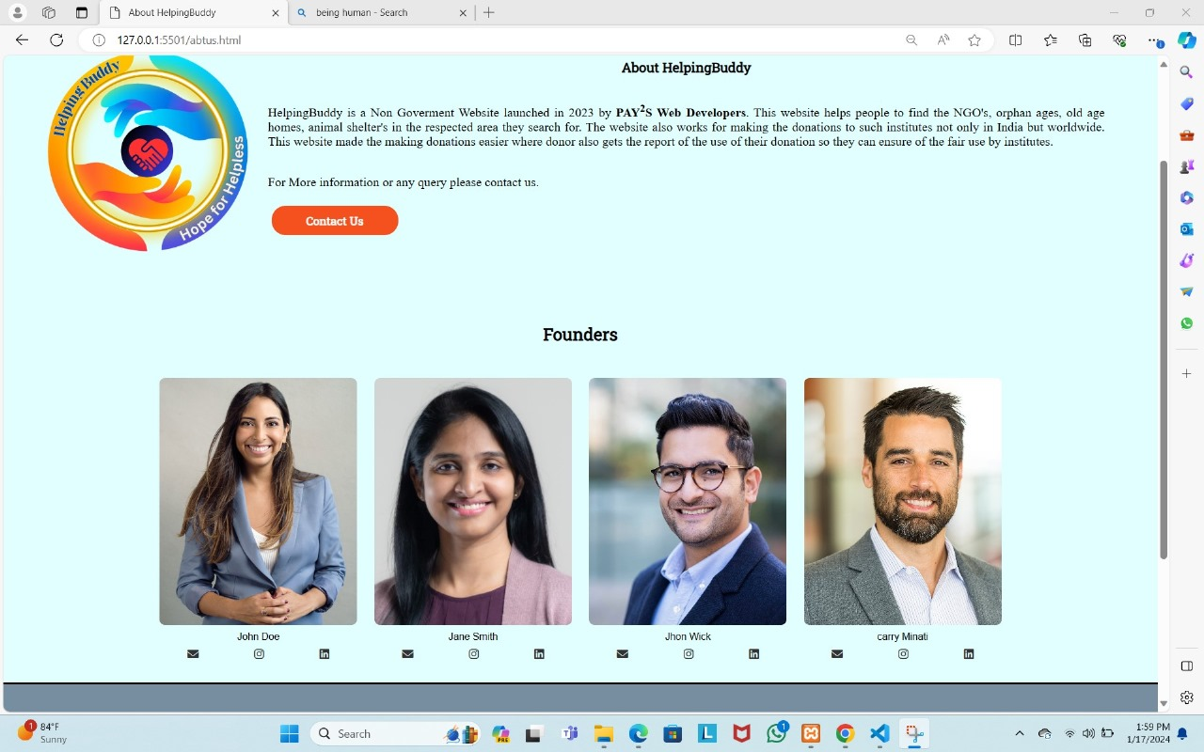
ABOUT US

Slide 17
Conclusion :
Here are some key points for the conclusion:
Philanthropic Mission: Helping Buddy appears to have a clear philanthropic mission aimed at addressing crucial social issues, including disaster relief, support for old age homes, and assistance for orphanages. The platform likely seeks to channel resources and aid towards those in need.
User-Friendly Interface: A successful donation and funding management platform should have a user-friendly interface. If Helping Buddy provides an intuitive and easy-to-navigate website, it would likely attract more users, encouraging greater participation in charitable activities.
Impactful Initiatives: The success of Helping Buddy can be measured by the positive impact it has on the beneficiaries of its initiatives. Regular updates, success stories, and tangible outcomes from the supported projects would showcase the platform's effectiveness in making a meaningful difference in the lives of those it aims to help.
Community Engagement: To thrive, Helping Buddy should actively engage with its community of donors, volunteers, and beneficiaries. Regular communication, updates, and engagement events can foster a sense of community and inspire continued support for the platform's initiatives.
In conclusion, if Helping Buddy effectively addresses these aspects, it has the potential to be a valuable platform for managing donations and funding for various causes, contributing positively to society. However, ongoing efforts to maintain transparency, security, and community engagement will be crucial for its sustained success in the realm of charitable endeavors.

Slide 18
Future Scope :
The future scope of Helping Buddy could include:
Expansion of Causes: Helping Buddy may extend its support to a wider range of causes and social issues, adapting to emerging needs and crises.
Global Reach: The platform might explore opportunities to go global, reaching out to international communities and addressing global humanitarian challenges.
Partnerships and Collaborations: Establishing partnerships with other NGOs, businesses, and governments could amplify Helping Buddy's impact and resource mobilization.
Community Building: Strengthening the sense of community among donors, volunteers, and beneficiaries through social media, events, and forums can foster sustained engagement and support.
Innovative Fundraising Campaigns: Implementing creative and innovative fundraising campaigns, such as crowd funding initiatives, virtual events, or collaborative projects, can keep the platform dynamic and responsive to evolving donor preferences.
Educational Initiatives: Launching educational programs to raise awareness about social issues, sustainable practices, and the impact of donations could contribute to a more informed and engaged donor base.
Mobile Application development : Development of an application for seamless donations could be part of its future developments.

Slide 19

THANK YOU

